Slide 1
Deep Learning
Anshu Pandey

Slide 2

Agenda
Deep Learning Introduction
Deep Learning v/s Machine Learning
Convolutional Neural Network
Example 1 – MNIST-CNN using keras

Slide 3
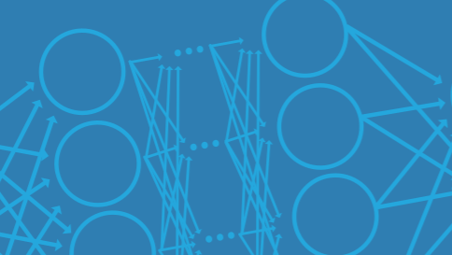
What is Deep Learning?
Deep learning is a type of machine learning in which a model learns to perform classification tasks directly from images, text, or sound.
Deep learning is usually implemented using a neural network architecture.
The term “deep” refers to the number of layers in the network—the more layers, the deeper the network. Traditional neural networks contain only 2 or 3 layers, while deep networks can have hundreds.

Slide 4
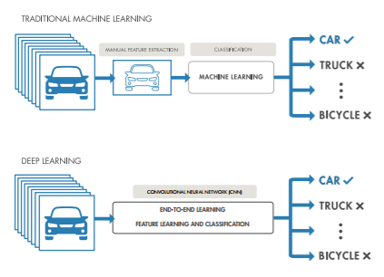
What is the Difference Between Deep Learning and Machine Learning?
Deep learning is a subtype of machine learning. With machine learning, you manually extract the relevant features of an image.
With deep learning, you feed the raw images directly into a deep neural network that learns the features automatically.

Slide 5
What is the Difference Between Deep Learning and Machine Learning?
Machine Learning | Deep Learning
+ Good results with small datasets | - Requires very large data sets
+ Quick to train a model | - Computationally Intensive
- Need to try different features and classifiers to achieve best results. | + Learns features and classifiers automatically
- Accuracy plateaus | + Accuracy is unlimited

Slide 6
Deep Learning Applications
Deep learning is especially well-suited to identification applications such as face recognition, text translation, voice recognition, and advanced driver assistance systems, including, lane classification and traffic sign recognition.
Here are just a few examples of deep learning at work:
A self-driving vehicle slows down as it approaches a pedestrian crosswalk.
An ATM rejects a counterfeit bank note.
A smartphone app gives an instant translation of a foreign street sign.

Slide 7
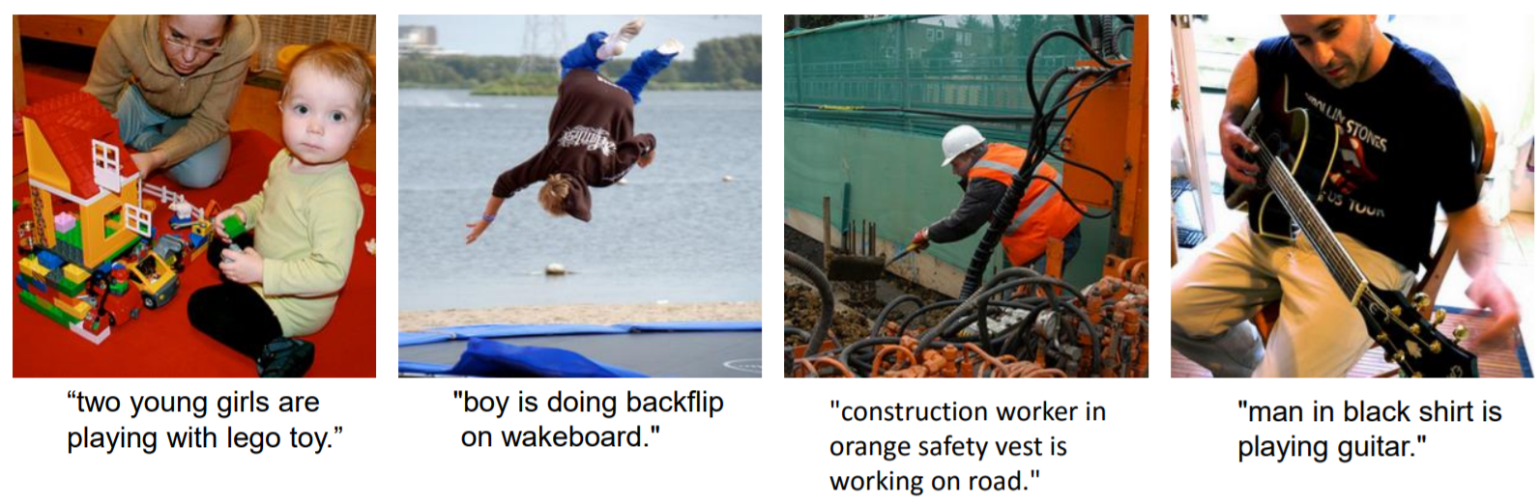
Image Captioning

Slide 8
Computational Resources for Deep Learning
Training a deep learning model can take hours, days, or weeks, depending on the size of the data and the amount of processing power you have available.
Currently, there are three computation options: CPU-based, GPUbased, and cloud-based.
CPU-based computation is the simplest and most readily available option. Using CPU-based computation only for simple examples using a pretrained network.
Using a GPU reduces network training time from days to hours.
Cloud-based GPU computation means that you don’t have to buy and set up the hardware yourself.

Slide 9
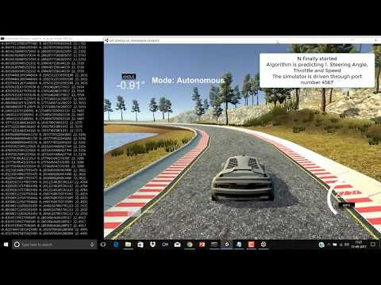
Self Driving Car Simulation using CNN

Slide 10
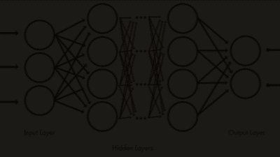
Inside a Deep Neural Network
A deep neural network combines multiple nonlinear processing layers, using simple elements operating in parallel and inspired by biological nervous systems.
It consists of an input layer, several hidden layers, and an output layer. The layers are interconnected via nodes, or neurons, with each hidden layer using the output of the previous layer as its input.

Slide 11


Slide 14
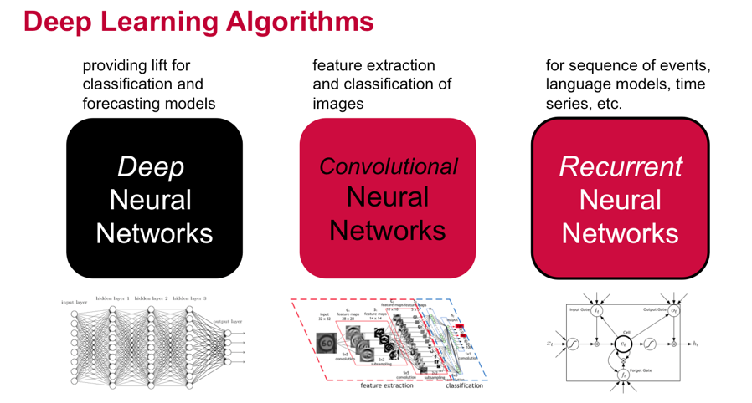

Slide 15
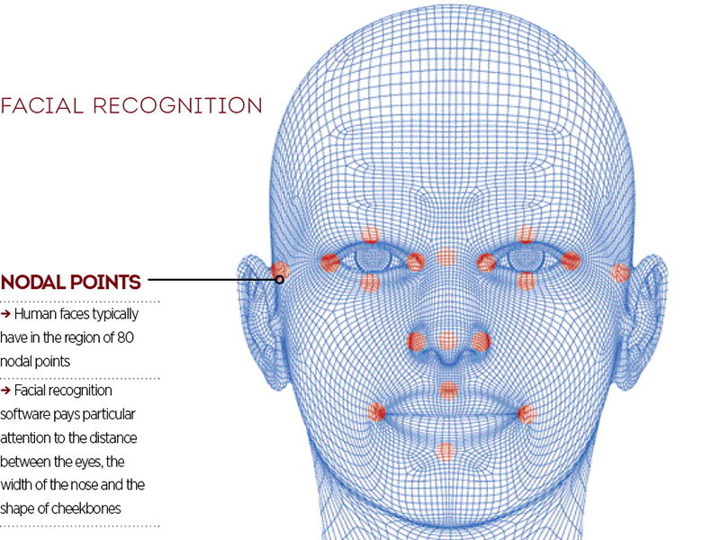
Convolutional Neural Network

Slide 16
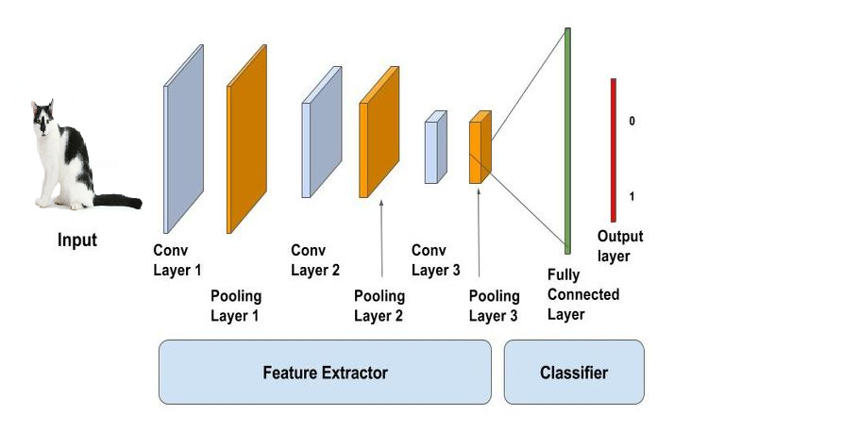
Convolutional Neural Networks
A convolutional neural network (CNN, or ConvNet) is one of the most popular algorithms for deep learning with images and video.
Like other neural networks, a CNN is composed of an input layer, an output layer, and many hidden layers in between.

Slide 17
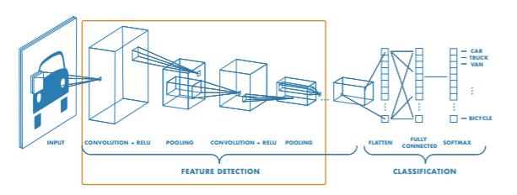
Feature Detection Layers
These layers perform one of three types of operations on the data: convolution, pooling, or rectified linear unit (ReLU).
Convolution puts the input images through a set of convolutional filters, each of which activates certain features from the images.
Pooling simplifies the output by performing nonlinear downsampling, reducing the number of parameters that the network needs to learn about.
Rectified linear unit (ReLU) allows for faster and more effective training by mapping negative values to zero and maintaining positive values.
These three operations are repeated over tens or hundreds of layers, with each layer learning to detect different features.

Slide 18
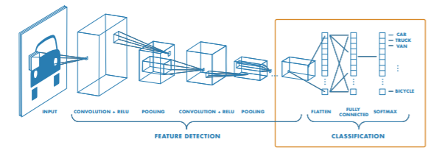
Classification Layers
After feature detection, the architecture of a CNN shifts to classification.
The next-to-last layer is a fully connected layer (FC) that outputs a vector of K dimensions where K is the number of classes that the network will be able to predict. This vector contains the probabilities for each class of any image being classified.
The final layer of the CNN architecture uses a softmax function to provide the classification output.

Slide 19
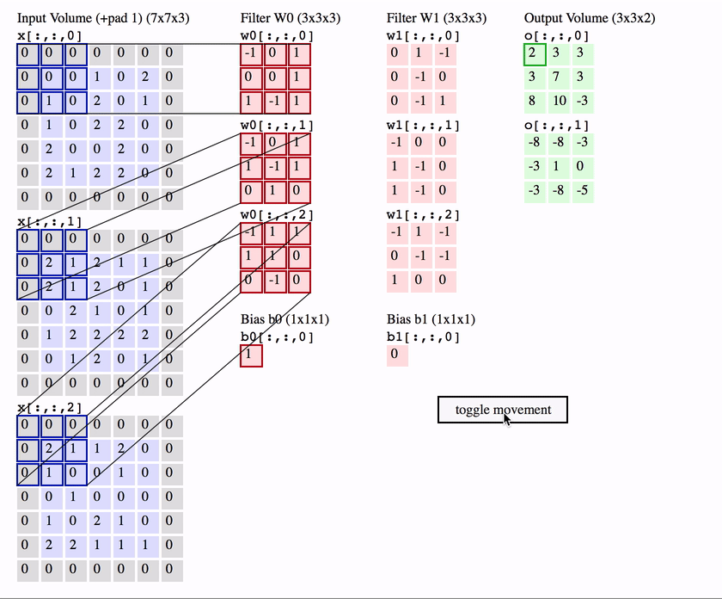
Convolution Process

Slide 20
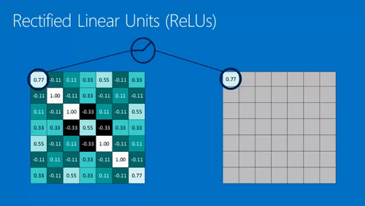
Relu

Slide 21

Maxpooling

Slide 22
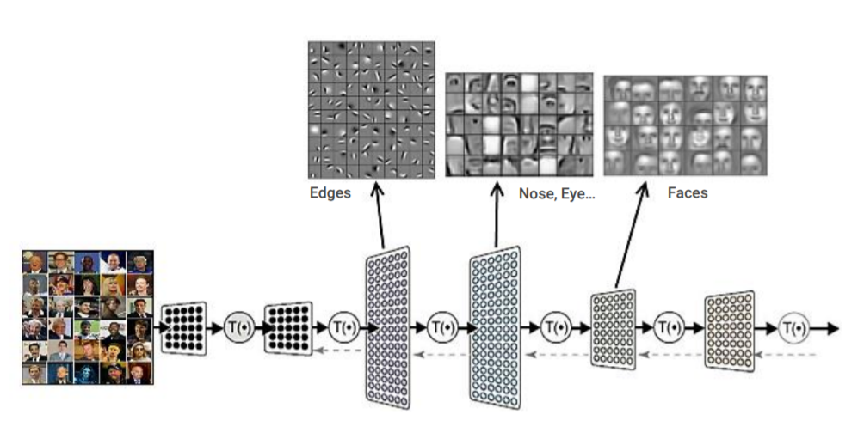

Slide 23
Example

Slide 24
MNIST Dataset
The MNIST database (Modified National Institute of Standards and Technology database) is a large database of handwritten digits that is commonly used for training various image processing systems. The database is also widely used for training and testing in the field of machine learning.
The MNIST database of handwritten digits, has a training set of 60,000 examples, and a test set of 10,000 examples. It is a subset of a larger set available from NIST. The digits have been size-normalized and centered in a fixed-size image of size 28x28.
It can manually be downloaded from - http://yann.lecun.com/exdb/mnist/

Slide 25
Importing libraries
import numpy as np
import tensorflow
from keras.models import Sequential
from keras.layers import Dense, Dropout, Flatten
from keras.layers.convolutional import Conv2D, MaxPooling2D
from keras import backend
import matplotlib.pyplot as plt
from keras.utils import np_utils

Slide 26
Load data
from keras.datasets import mnist
# Load data and target from MNIST data
(train_data, train_target), (test_data, test_target) = mnist.load_data()

Slide 27
Feature Engineering on data
# Set image information
channels = 1
height = 28
width = 28
# Reshape training image data into features
train_data = train_data.reshape(train_data.shape[0], channels, height, width)
# Reshape test image data into features
test_data = test_data.reshape(test_data.shape[0], c

Slide 28
Feature Engineering on data
# Rescale pixel intensity to between 0 and 1
train_features = train_data / 255
test_features = test_data / 255
# One-hot encode target
train_target = np_utils.to_categorical(train_target)
test_target = np_utils.to_categorical(test_target)
number_of_classes = test_target.shape[1]

Slide 29
Convolutional Neural Network
# Start neural network
network = Sequential()

Slide 30
Convolutional Neural Network
# Add convolutional layer with 64 filters, a 5x5 window, and
# ReLU activation function
network.add(Conv2D(filters=64, kernel_size=(5, 5), input_shape=(channels, width, height), activation='relu'))

Slide 31
Convolutional Neural Network
# Add max pooling layer with a 2x2 window
network.add(MaxPooling2D(pool_size=(2, 2)))

Slide 32
Convolutional Neural Network
# Add dropout layer
network.add(Dropout(0.5))

Slide 33
Convolutional Neural Network
# Add layer to flatten input
network.add(Flatten())

Slide 34
Convolutional Neural Network
# Add fully connected layer of 128 units with a ReLU activation function
network.add(Dense(128, activation='relu'))

Slide 35
Convolutional Neural Network
# Add dropout layer
network.add(Dropout(0.5))

Slide 36
Convolutional Neural Network
# Add fully connected layer with a softmax activation function
network.add(Dense(number_of_classes, activation='softmax'))

Slide 37
Compile Convolutional Neural Network
# Compile neural network
network.compile(loss='categorical_crossentropy', # Cross-entropy
optimizer='rmsprop', # Root Mean Square Propagation
metrics=['accuracy']) # Accuracy performance metric

Slide 38
Train Convolutional Neural Network
# Train neural network
network.fit(train_features, # Features
train_target, # Target
epochs=2, # Number of epochs
verbose=0, # Don't print description after each epoch
batch_size=1000, # Number of observations per batch
validation_data=(test_features, test_target))# evaluation

Slide 39
Prediction
# predicting the image
img=test_data[0]
network.predict_classes(img.reshape(1,1,28,28))
# visualizing the image
plt.imshow(img.reshape(28,28),cmap='gray')
plt.show()

Slide 40
Use cases
Text Processing ( Sensitivity Analysis, Named Entity recognition)
- RNTN (Recursive Neural Tensor Network) OR Recurrent Net
Image Recognition – DBN(Deep Belief Network), Convolution Net
Object Recognition – RNTN, Convolution Net
Speech Recognition - Recurrent Net

Slide 41
For Projects http://cs229.stanford.edu/projects2013.html
For python Libraries http://www.lfd.uci.edu/~gohlke/pythonlibs/
For ML Data http://archive.ics.uci.edu/ml/index.php
Scikit-Learn http://scikit-learn.org/stable/
Data Mining Book https://www.amazon.com/dp/0123748569

Slide 42

Thank you
Anshu Pandey
https://www.linkedin.com/in/anshupandey/

